Slide 1
Hypothesis Testing: Imaging Clinical Trials
Julie DiCarlo, Ph.D.
18 August 2016

Slide 2
Hypothesis Testing: Some* Imaging Clinical Trials
Julie DiCarlo, Ph.D.
18 August 2016
* The ones that use scoring

Slide 3
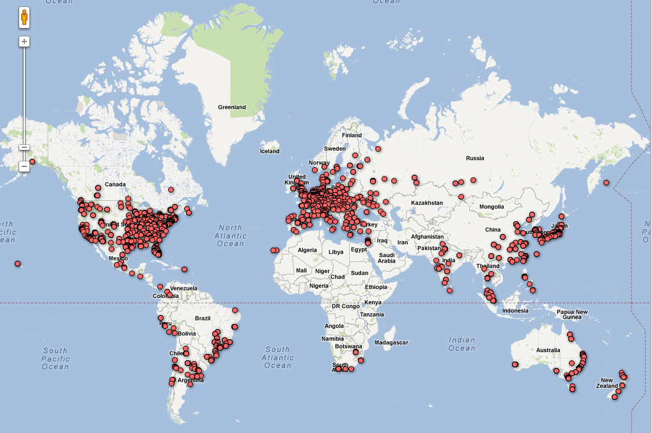
Trials Require Global Recruitment
One doctor cannot recruit all patients to get sufficient power
Notes:
3

Slide 4
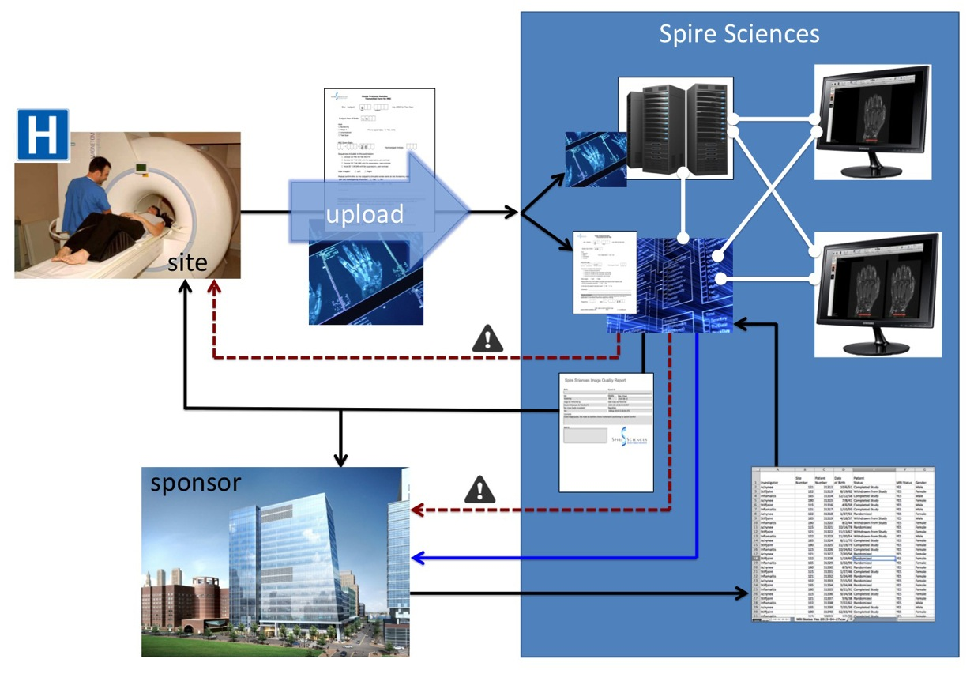
Imaging Data Flow
Trial CRO (study radiologists)

Slide 5
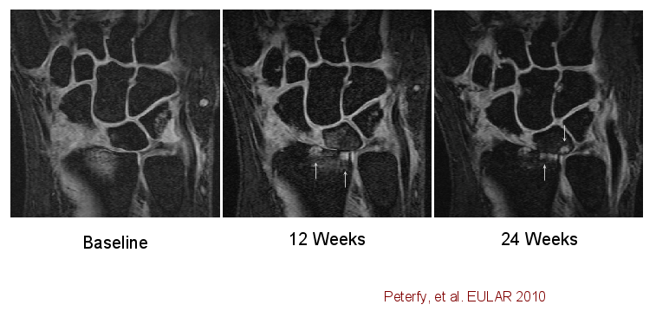
2-5 visits scored
Image order jumbled at scoring (radiologists are “blinded”)

Slide 6
Data analysis
Raw data transferred to client
One record per location-feature-reader-visit
>100K records:
50-200 subjects
2 readers
2-5 visits
4+ features
8-20 locations

Slide 7
Statistical Analyses
Wilcoxon Rank-Sum Test
non-parametric t-test
Van Elteren: version that stratifies subgroups recruited (example: subjects that start with erosions vs. having none)
All tests two-sided
5% significance level

Slide 9
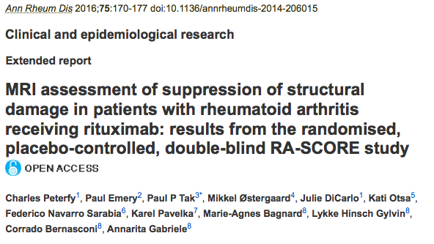
RA-SCORE: a MRI Rheumatoid Arthritis Study
Ann Rheum Dis 2016;75:170-177

Slide 10
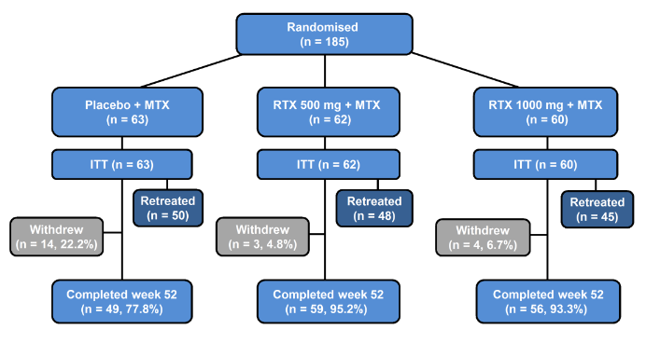
Missing data: dropouts

Slide 11
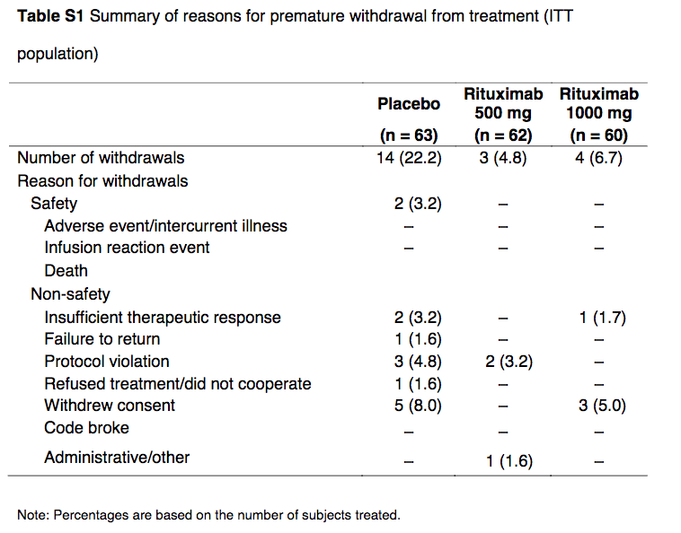
Dropouts

Slide 12
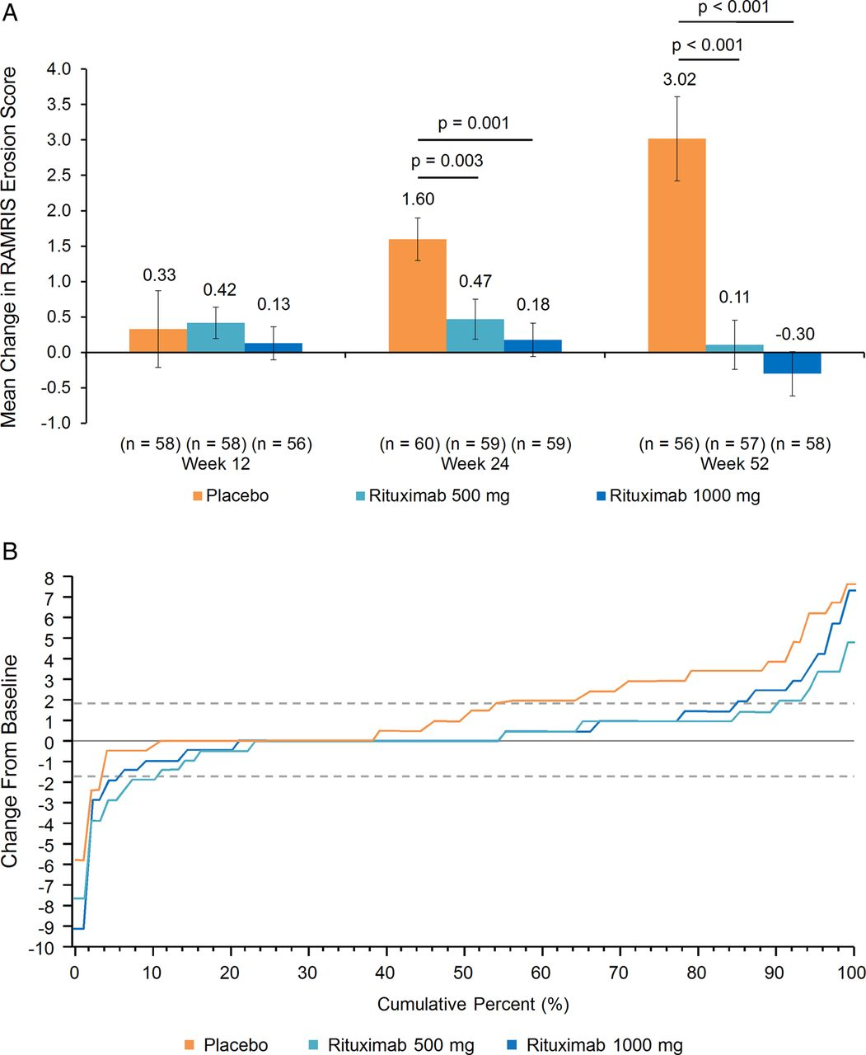

Primary end point.
Charles Peterfy et al. Ann Rheum Dis 2016;75:170-177
©2016 by BMJ Publishing Group Ltd and European League Against Rheumatism
Notes:
Primary end point. (A) Mean change in rheumatoid arthritis MRI Scoring (RAMRIS) erosion score (intent-to-treat (ITT) population). Missing values were imputed using linear extrapolation. Error bars represent the SE of the mean. (B) Cumulative distribution of change in RAMRIS erosion score at week 24. Missing values were imputed using linear extrapolation, ITT population. Broken horizontal lines represent ±SDC (smallest detectable change, determined according to the method of Bruynesteyn, et al.24 SDCs were 1.88 for RAMRIS erosion score, 1.54 for CARLOS, 2.11 for RAMRIS osteitis score and 1.56 for RAMRIS synovitis score).

Slide 13
RAMRIS Erosion Score Change
Charles Peterfy et al. Ann Rheum Dis 2016;75:170-177
©2016 by BMJ Publishing Group Ltd and European League Against Rheumatism
Notes:
Primary end point. (A) Mean change in rheumatoid arthritis MRI Scoring (RAMRIS) erosion score (intent-to-treat (ITT) population). Missing values were imputed using linear extrapolation. Error bars represent the SE of the mean. (B) Cumulative distribution of change in RAMRIS erosion score at week 24. Missing values were imputed using linear extrapolation, ITT population. Broken horizontal lines represent ±SDC (smallest detectable change, determined according to the method of Bruynesteyn, et al.24 SDCs were 1.88 for RAMRIS erosion score, 1.54 for CARLOS, 2.11 for RAMRIS osteitis score and 1.56 for RAMRIS synovitis score).

Slide 14
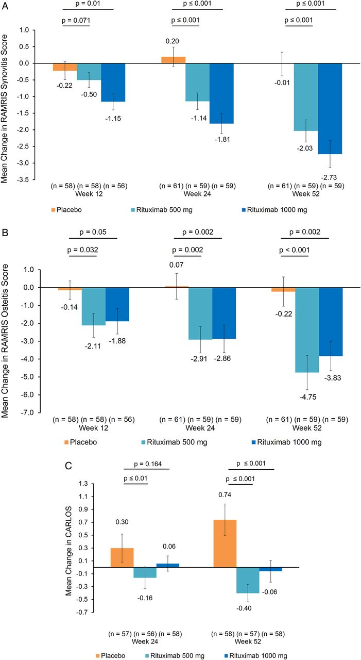
Charles Peterfy et al. Ann Rheum Dis 2016;75:170-177
Mean changes in rheumatoid arthritis MRI Scoring (RAMRIS) synovitis
(intent-to-treat population).
©2016 by BMJ Publishing Group Ltd and European League Against Rheumatism
Notes:
Mean changes in rheumatoid arthritis MRI Scoring (RAMRIS) synovitis, RAMRIS osteitis and MRI cartilage loss score (CARLOS) (intent-to-treat population). (A) Synovitis. Missing values were imputed using last observation carried forward. Error bars represent the SE of the mean. (B) Osteitis. Missing values were imputed using last observation carried forward. Error bars represent the SE of the mean. (C) Cartilage loss. Error bars represent the SE of the mean.

Slide 15
Charles Peterfy et al. Ann Rheum Dis 2016;75:170-177
Mean changes in rheumatoid arthritis MRI Scoring (RAMRIS) osteitis
(intent-to-treat population)
©2016 by BMJ Publishing Group Ltd and European League Against Rheumatism
Notes:
Mean changes in rheumatoid arthritis MRI Scoring (RAMRIS) synovitis, RAMRIS osteitis and MRI cartilage loss score (CARLOS) (intent-to-treat population). (A) Synovitis. Missing values were imputed using last observation carried forward. Error bars represent the SE of the mean. (B) Osteitis. Missing values were imputed using last observation carried forward. Error bars represent the SE of the mean. (C) Cartilage loss. Error bars represent the SE of the mean.

Slide 16
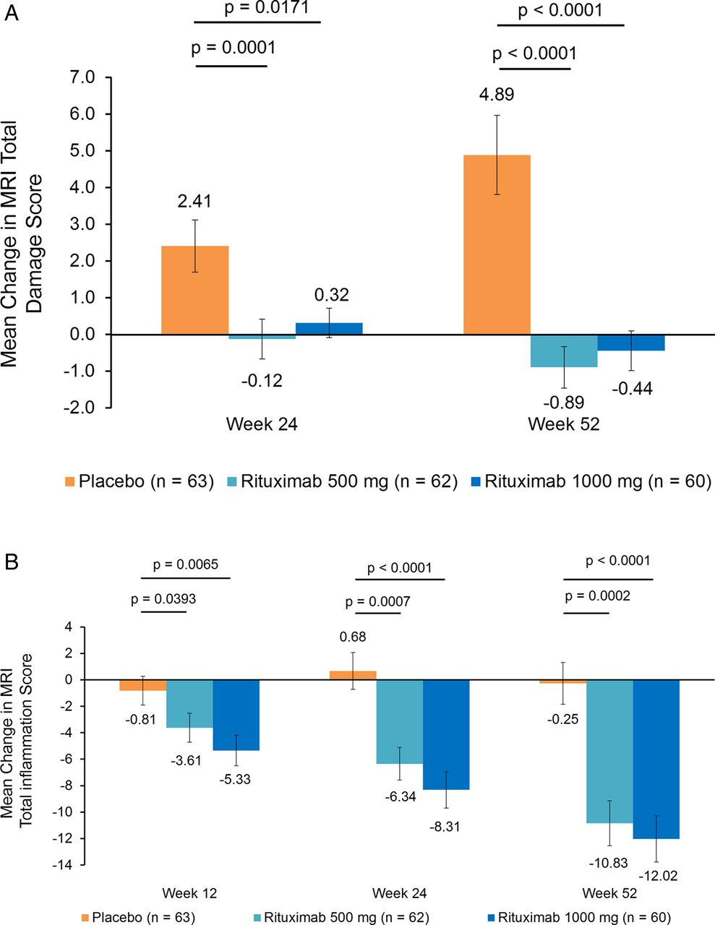
Mean change in total inflammation scores.
Charles Peterfy et al. Ann Rheum Dis 2016;75:170-177
©2016 by BMJ Publishing Group Ltd and European League Against Rheumatism
Notes:
Mean change in total damage and total inflammation scores. (A) Total damage score. Total damage score=erosion score+(2.5×cartilage loss score). Missing values were imputed using linear extrapolation using baseline and week 12 images. Error bars represent the SE of the mean. (B) Total inflammation score. Total inflammation score=osteitis score+(3×synovitis score). Missing values were imputed using linear extrapolation using baseline and week 12 images. Error bars represent the SE of the mean.

Slide 17
Mean changes in rheumatoid arthritis MRI cartilage loss score (CARLOS)
(intent-to-treat population).
Charles Peterfy et al. Ann Rheum Dis 2016;75:170-177
©2016 by BMJ Publishing Group Ltd and European League Against Rheumatism
Notes:
Mean changes in rheumatoid arthritis MRI Scoring (RAMRIS) synovitis, RAMRIS osteitis and MRI cartilage loss score (CARLOS) (intent-to-treat population). (A) Synovitis. Missing values were imputed using last observation carried forward. Error bars represent the SE of the mean. (B) Osteitis. Missing values were imputed using last observation carried forward. Error bars represent the SE of the mean. (C) Cartilage loss. Error bars represent the SE of the mean.

Slide 18
Mean change in total damage and total inflammation scores.
Charles Peterfy et al. Ann Rheum Dis 2016;75:170-177
©2016 by BMJ Publishing Group Ltd and European League Against Rheumatism
Notes:
Mean change in total damage and total inflammation scores. (A) Total damage score. Total damage score=erosion score+(2.5×cartilage loss score). Missing values were imputed using linear extrapolation using baseline and week 12 images. Error bars represent the SE of the mean. (B) Total inflammation score. Total inflammation score=osteitis score+(3×synovitis score). Missing values were imputed using linear extrapolation using baseline and week 12 images. Error bars represent the SE of the mean.

Slide 19
P-values
Does not take into account the size of the observed effect
small effect with large sample size can have same P value as large effect in small study
Judgment intended with hypothesis test
Care more about false-negative or false-positive error rates?
Goodman, SN. Ann Intern Med.1999;130:995-1004.

Slide 20
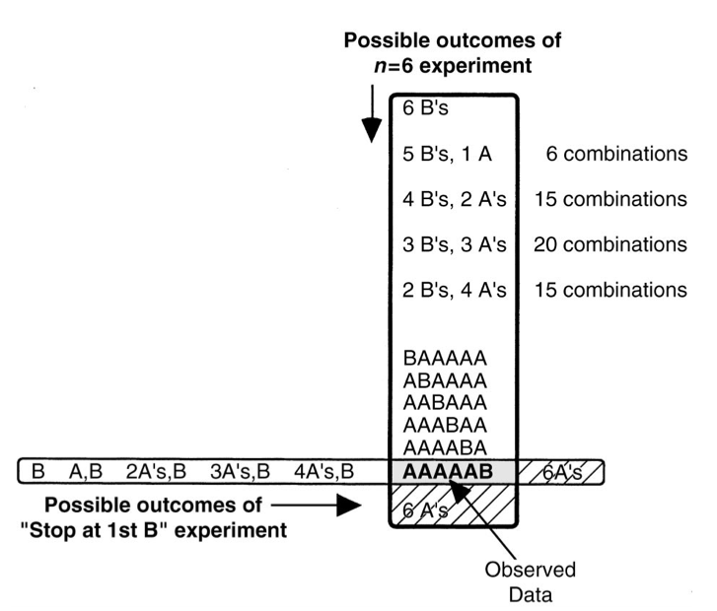
Example: 6 patients try drugs A and B
Better treatment results: A A A A A B
6 planned patients: P value = 0.11
Stop until B is better up to 6: P value = 0.03
Goodman, SN. Ann Intern Med.1999

Slide 21
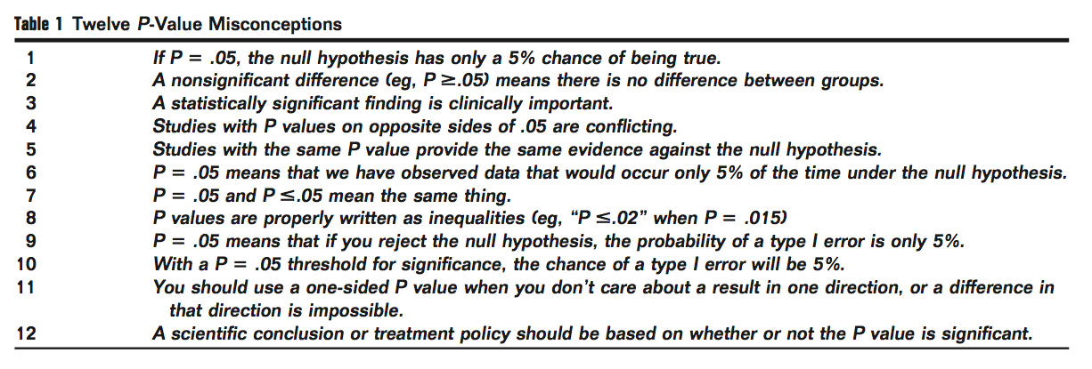
True or False?

Slide 22
True or False?
Goodman, SN. Semin Hematol 45:135-140

Slide 23
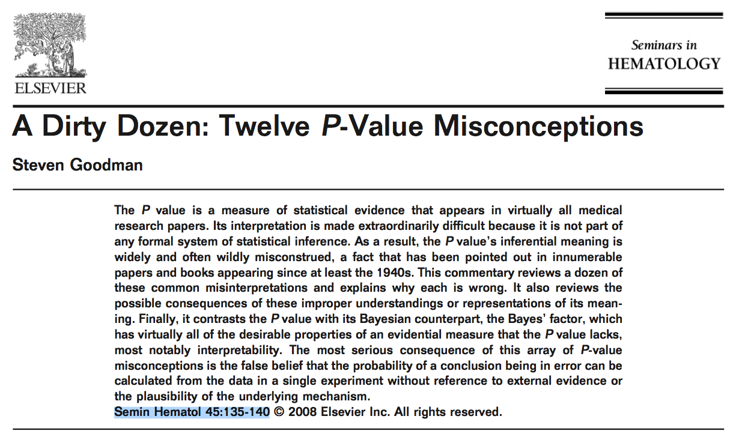

Slide 24


Slide 25
Remember: Use Context
Experimental design
Historical results (example: do placebo groups behave similarly across studies?)
Sample conditions

Slide 26


